Slide 1
Overview of the UAE’s Foreign Aid Sector

Slide 2
History of the UAE’s Foreign Aid Sector
1971
1983
UAE Red Crescent Authority
1992
Zayed Bin Sultan Al Nahyan Foundation
1992- 2012
More than 40 donor organizations
2008
The UAE Office for the Coordination of Foreign Aid (OCFA)
2013
The Ministry of International Cooperation and Development (MICAD)
UAE Established
1971
Abu Dhabi Fund For Development ( July)

Slide 3
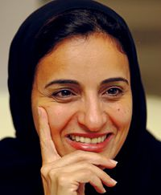
Establishment of MICAD
Established on 12 March 2013
Her Excellency Sheikha Lubna Bint Khalid Al Qasimi appointed as Minister of MICAD.
Prior to that she was a Minister of Economy (2004-2008).
Minister of Foreign Trade (2009-2013).
Notes:
Mention ( Shk. Lubna was minister for ( economy & Foreign trade) before

Slide 4
About MICAD
Vision
An enhanced regional and international profile of the UAE in international development and cooperation.
Mission
MICAD seeks to support international development through UAE foreign-aid policy; development programs which maximize the impact of the country’s foreign assistance; and enhanced cooperation with national, regional, and international actors.

Slide 5
MICAD’s Objectives
Develop UAE foreign aid policy.
Develop and manage a quality aid program.
Strengthen the role and participation of the UAE in international Development and humanitarian response.
Enhance cooperation with other donor countries and with regional and international development organizations, and contribute to the consideration of global aid issues.
Ensure quality standards.

Slide 6
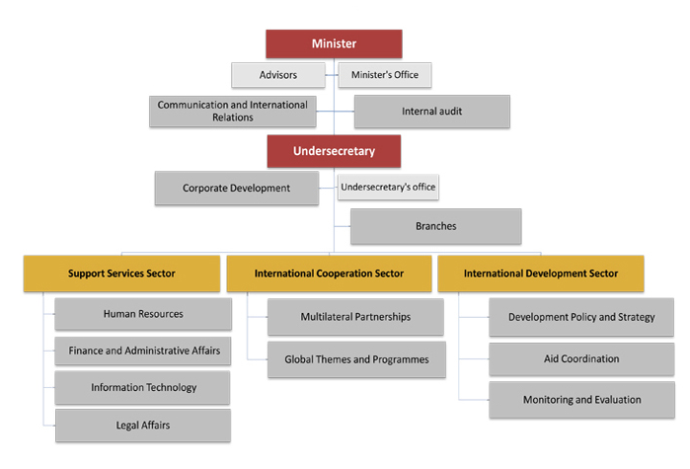
MICAD Operational Sectors

Slide 7
ODA/ GNI Ratio in 2010-2012

Slide 8
UAE Aid in 2010-2012 Top Five – By UAE Donors

Slide 9
UAE Aid in 2010-2012 Top Five – By Sectors

Slide 10
UAE Aid in 2010-2012 Top Five – By Continent

Slide 11
MAIN TASKS OF MICAD’s Monitoring and Evaluation Department
Establish and develop evaluation framework
Establish and develop monitoring framework
Develop evaluation standards
Establish UAE Monitoring, Evaluation and Learning Group
Capacity Building for the UAE donors on M&E standards
Monitor and Evaluate UAE Bilateral aid
Monitor and Evaluate UAE Multilateral aid
Evaluate MICAD’s bilateral partnerships

